Slide 1


“Summix” An Automated Privacy Policy Analyzer and Summarizer
Supervisor:
Dr. Omer Beg

Slide 2






Problem Statement
Protect personal information and Data
1
Millions of Applications and websites which we daily use.
1
2
What about the personal data which we upload daily on the platforms.
2
3
4
3
Do they Protect my data?
4
Can they steal my data?

Slide 3
Goals
Difficult to read
Brief Details
Time is worthy
End user agreements are usually long texts and the user is too lazy to read
Summarized text is expected to be concise and comprehensive.
Discard the time-consuming strategy of reading the complete privacy policies.
Agree without Reading- Risk
Preserve Important Information
Without reading we may agree to something which may prove to be a threat to our personal data
Processing the Privacy Policies into short summarized bullet points.

Slide 4

Use Cases
01
Search Privacy Policy with URL
Search Privacy Privacy in the search bar, scrap its text from the URL link to generate its summary
Use Case
Extractive Summarization of Privacy Policy
02
After Analyzing the Privacy Policy, generate its extractive summary in form of Bullet Points
Use Case
03
Abstractive Summarization of Privacy Policy
After Analyzing the Privacy Policy, generate its abstractive- human like summary
Use Case
Visualization of Keywords
04
Visualize the key words from the resulted summary
Use Case

Slide 5
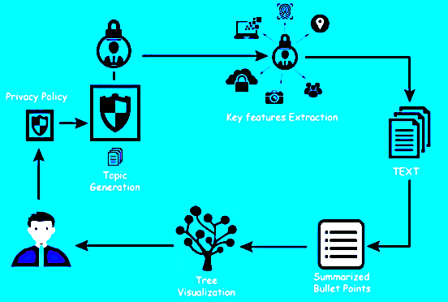
Architecture

Slide 6
Dataset Description
Data Set
Abstractive Summarization
There was no open-sourced dataset available.
We scraped more than 10 thousand Privacy Policies from Top websites listed by Alexa.com and other such platforms and Cleaned the scraped data.
This dataset was unlabeled, and it was a problem of Unsupervised Learning.
For our Abstractive Summarization we created our own labels of the dataset in order to use it in our Abstractive Model
Usage
Description
Extractive Summarization
For Extractive Summarization we used the original scraped unlabeled dataset.

Slide 7
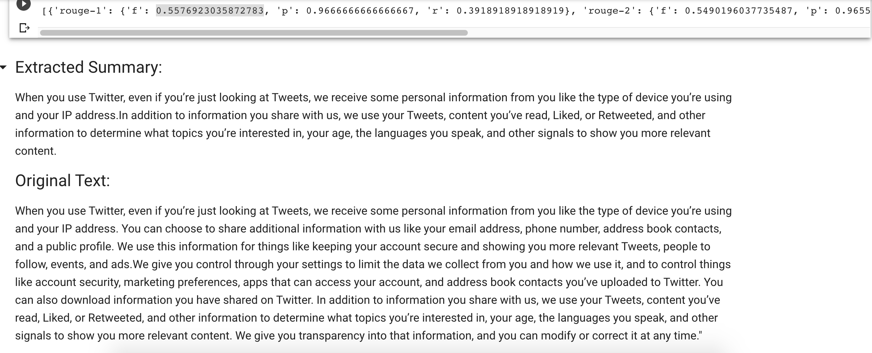
Extractive Summarization Methodology
Data
Pre-Processing
Removed longer contractions
Lemmatizations
Removed Stop words
Main Idea:
Sentences “recommend” other similar sentences to the reader and give a score to each sentence. The top 2 sentences are taken as extractive summary.
Algorithm:
Lexrank Algorithm:
“Graph-based centrality scoring of sentences”.
Fig. Sample Result

Slide 8
Abstractive Summarization Methodology
Data
Pre-Processing
Removed longer contractions
Lemmatizations
Removed unwanted characters
Removed stop words
Embeddings
Used ConceptNet word Embeddings
Dimensions: {2,300}
English Vocabulary Size : 516782 words
Model:
“Seq2Seq Model with Bidirectional LSTM’s and Attention Mechanism”
Fig. Comparison of ConceptNet with other embeddings on on benchmarks of word similarity.

Slide 9
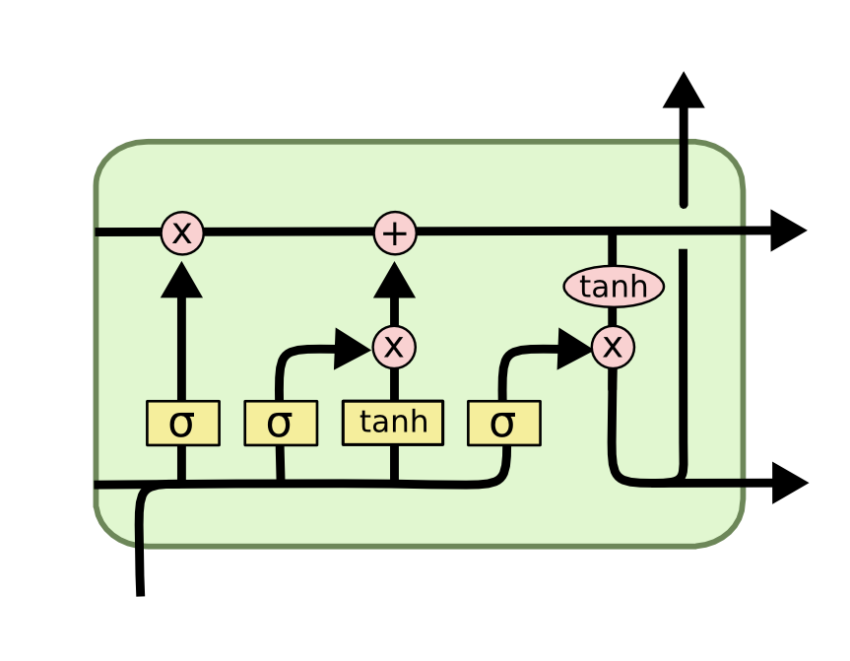
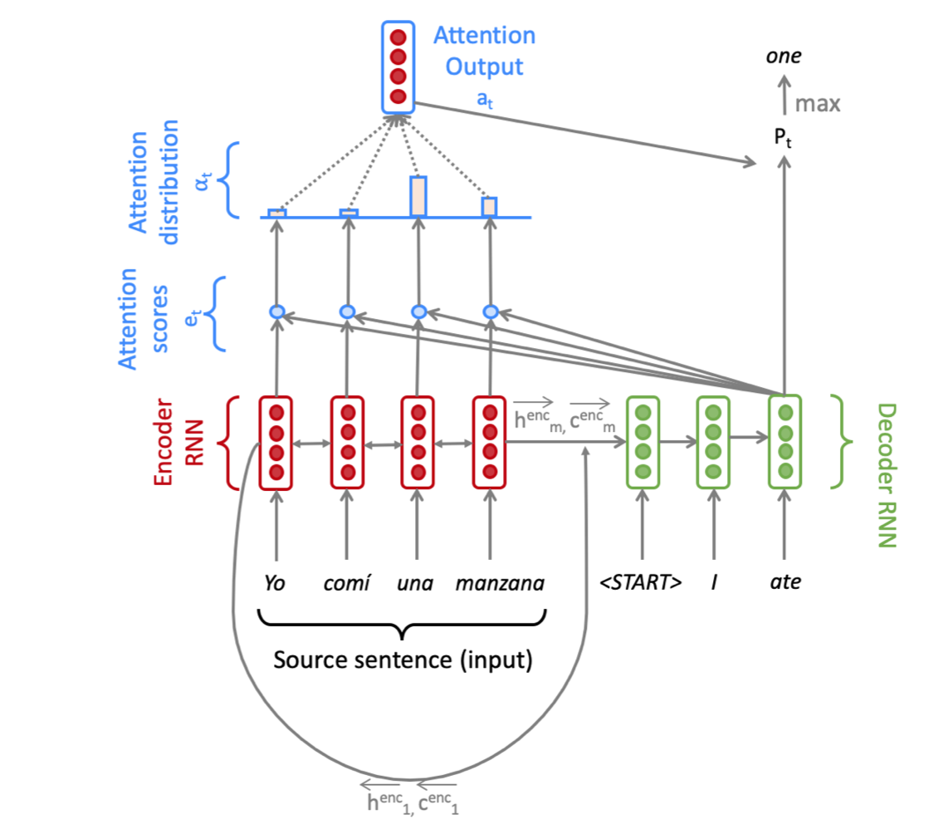
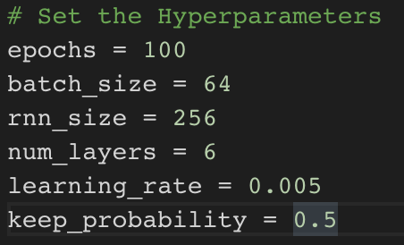
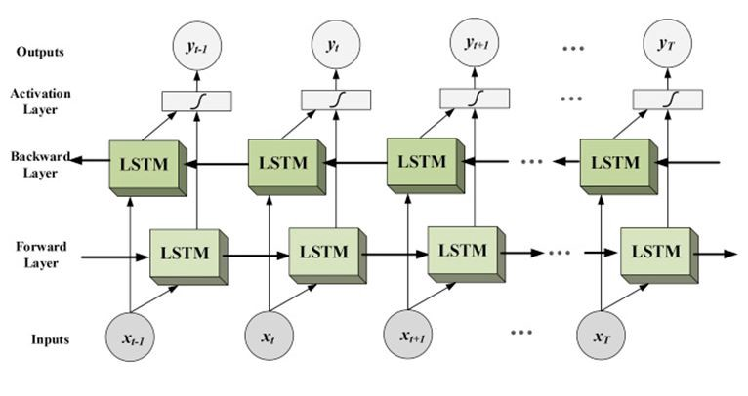
Model
Details
Model hypermeters:
Fig. LSTM Structure
Fig. Attention Mechanism
Fig. Bi-Directional LSTM’s

Slide 10
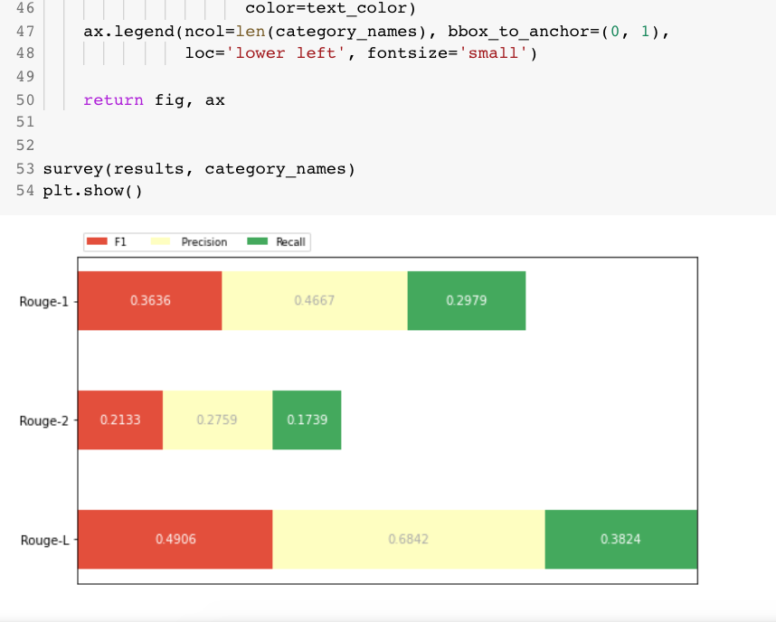
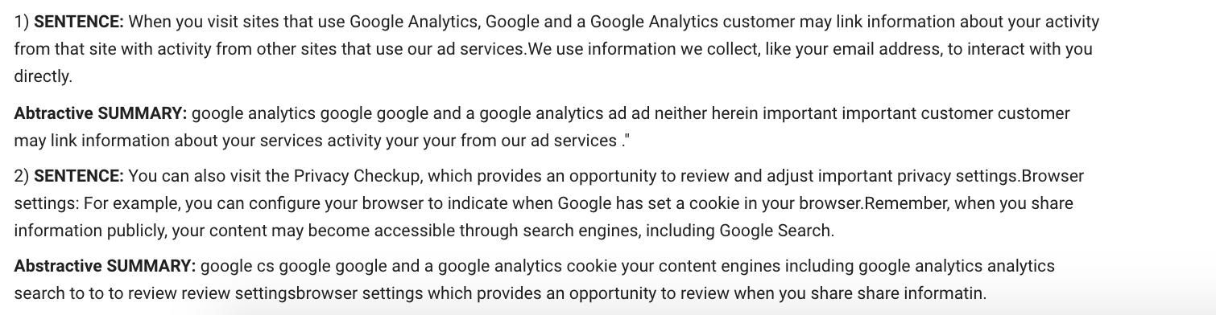
Evaluation Scores
Abstractive Summarization

Slide 11
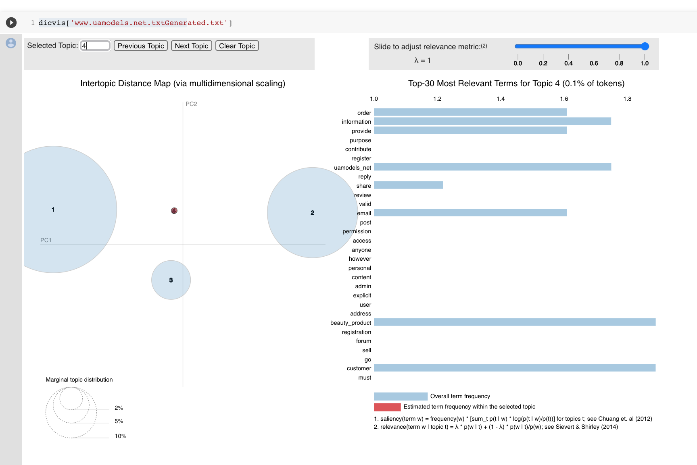
Topic Keywords Visualization
Keywords Generation
Visualize top keywords of every paragraph.

Slide 12
Work-Flow
Sep-Oct’19
Nov-Dec’19
Jan-Feb’20
March-June’20
Requirement Gathering
Data Scraping
Data Cleaning
Data PreProcessing
Topic Attribute Extraction
Extractive Summarization
Model Training
Abstractive Summarization
App Development
Integration of Model and App
Topic Visualization
Integrated Testing
Improvement of Results
Final testing

Slide 13

Demo- Let’s take a look how “Summix” works

Slide 14
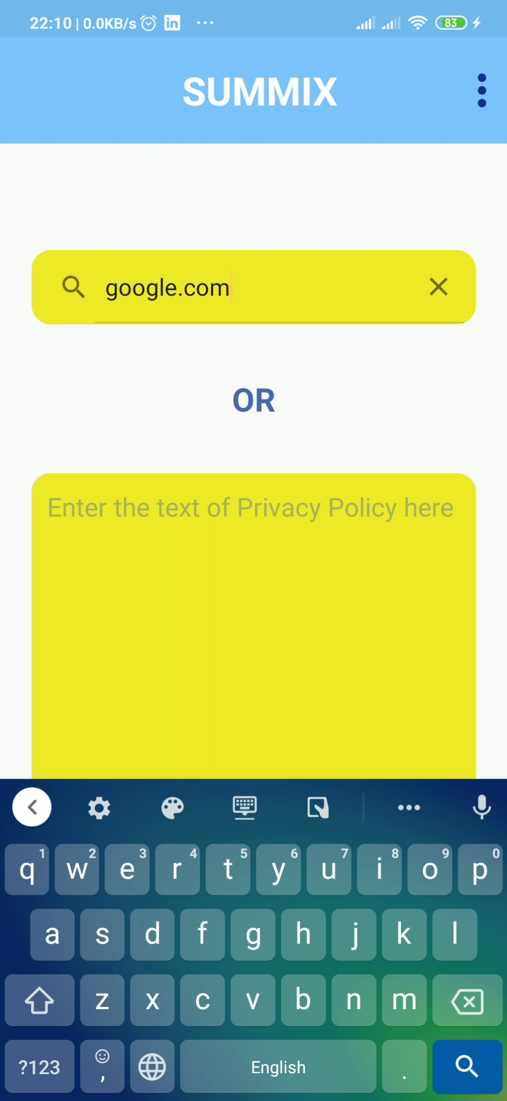
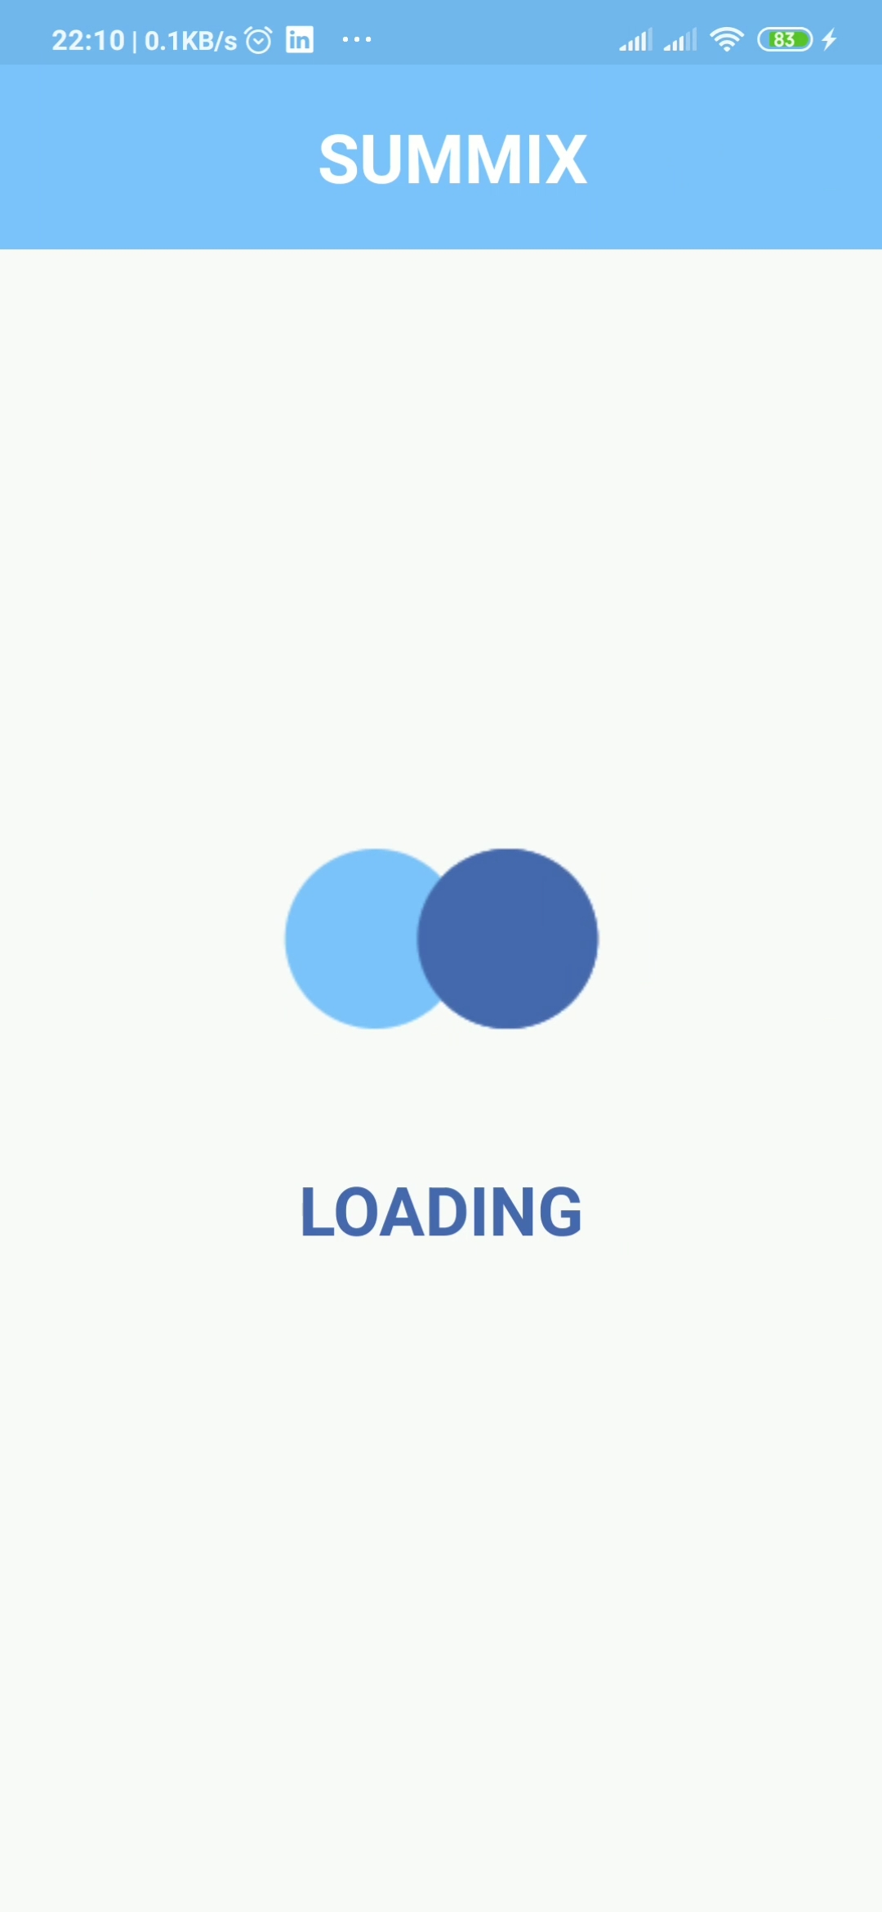
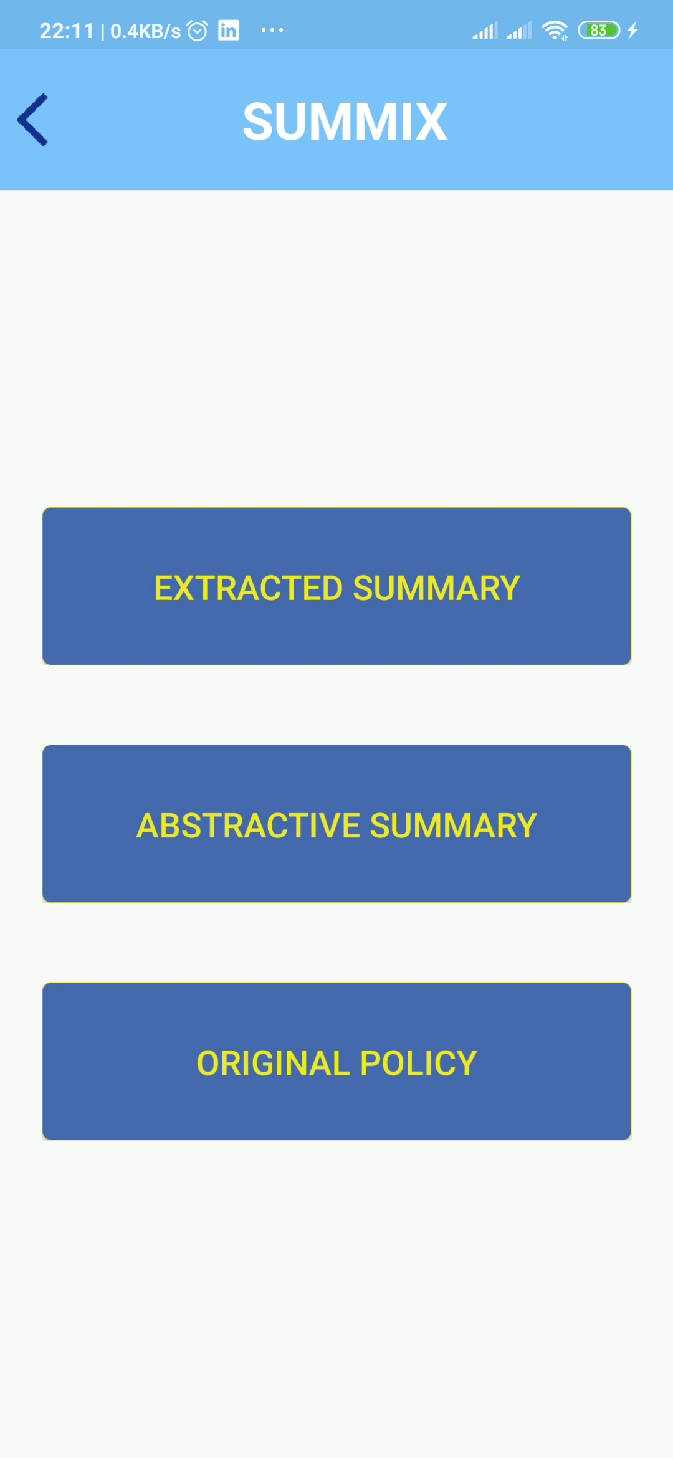
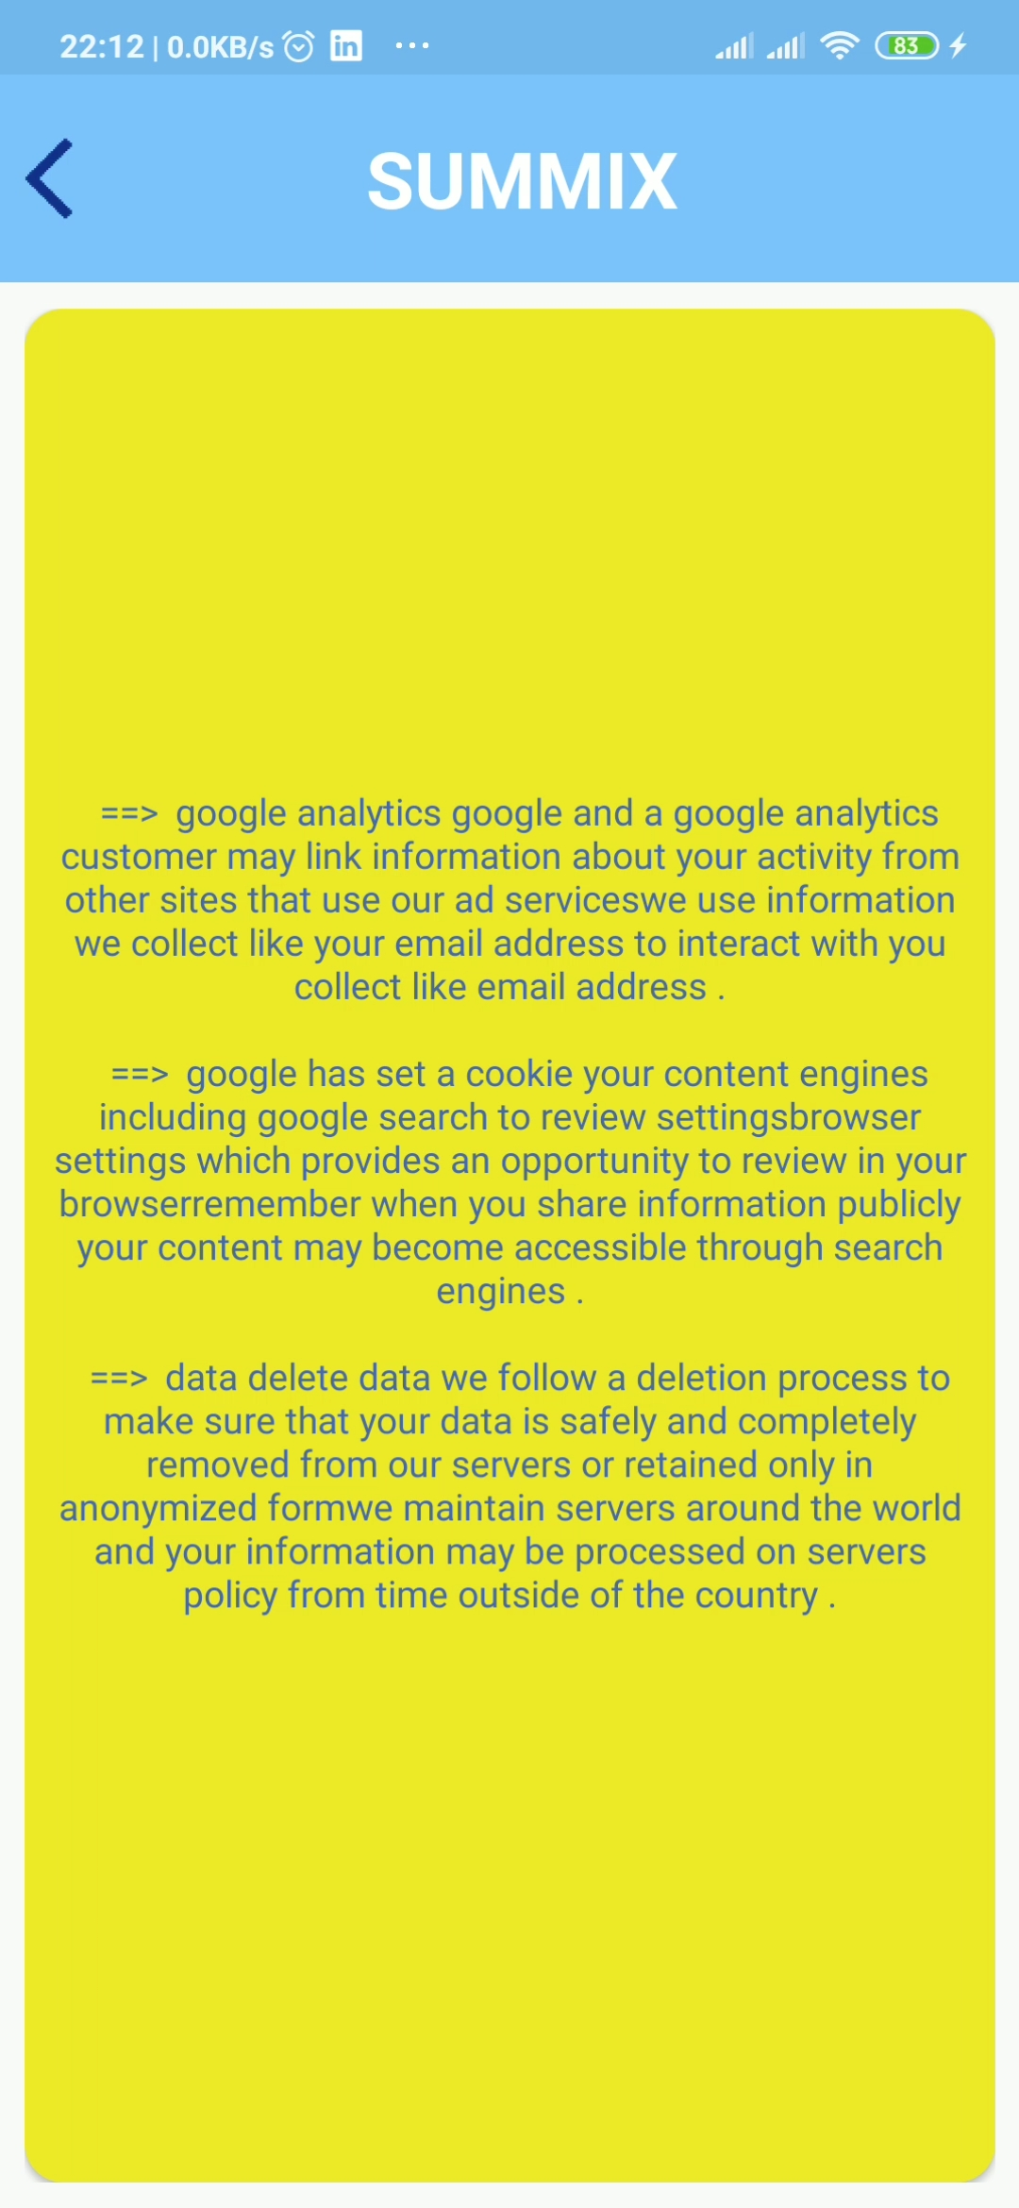

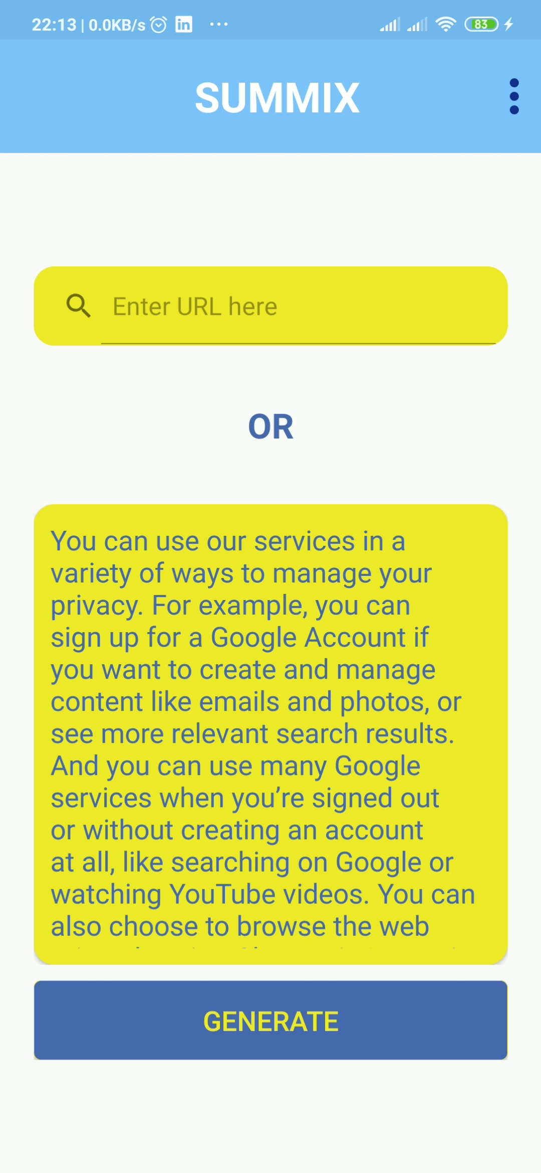
Demo

Slide 15

Thank You!

